Slide 1
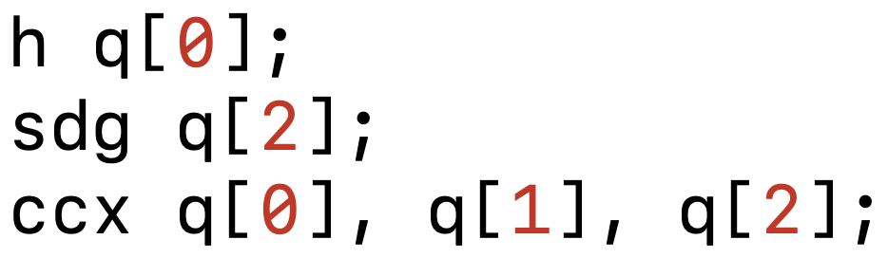
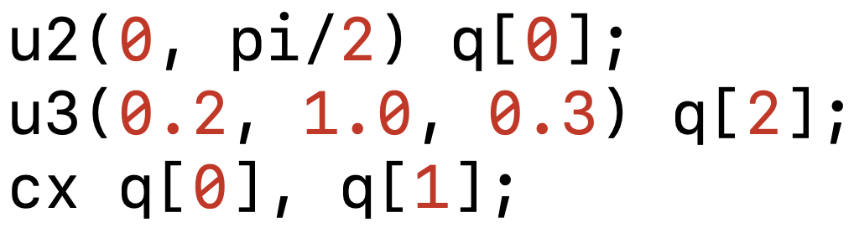
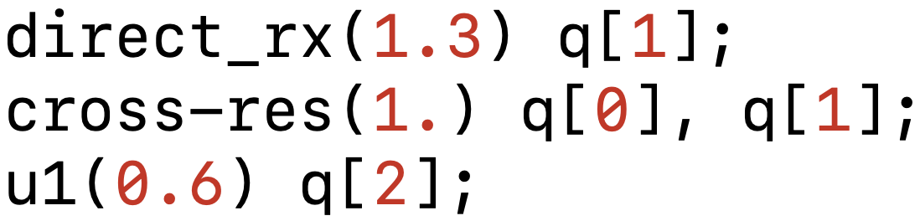
Programming Language
Assembly
Basis Gates
Pulse Schedule
Augmented Basis Gates
Optimized Schedule
Standard Compilation Flow
Our Work

Slide 3
def qaoa_mixing(N, beta):
for i in range(N):
circ.rx(beta, i)
h q[0];
sdg q[2];
ccx q[0], q[1], q[2];
u2(0, pi/2) q[0];
u3(0.2, 1.0, 0.3) q[2];
cx q[0], q[1];
ZZInt(0.3) q[0], q[1];
DirectRX(1.3) q[1];
cx q[0], q[1];4
direct_rx(1.3) q[1];
cross-res(1.) q[0], q[1];
u1(0.6) q[2];
zint(0.3) q[0], q[1];
circ = QuantumCircuit(N)
for edge in edges:
circ.zz_int(𝛄, edge)

Slide 4
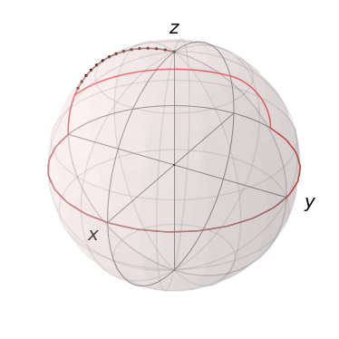
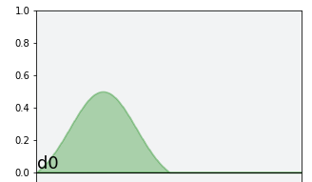
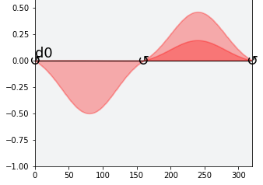
dt

Slide 5
